Slide 1

Microcontrollers

Slide 2

Chapter 2
8051 MICROCONTROLER ARCHITECTURE
1

Slide 3
Chapter 2. 8051 microcontroller architecture
2.1. Introduction to 8051 microcontrollers
2.2. Block diagram and pins
2.3. Memory
2.4. Special function registers
2.5. Reset operation

Slide 4
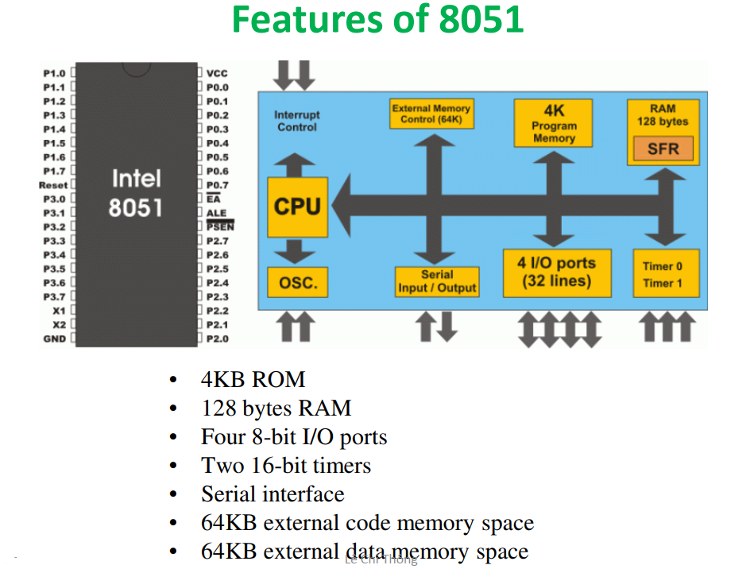
Chapter 2. 8051 MICROCONTROLER ARCHITECTURE
2.1 Introduction to 8051 Microcontroler
1

Slide 5
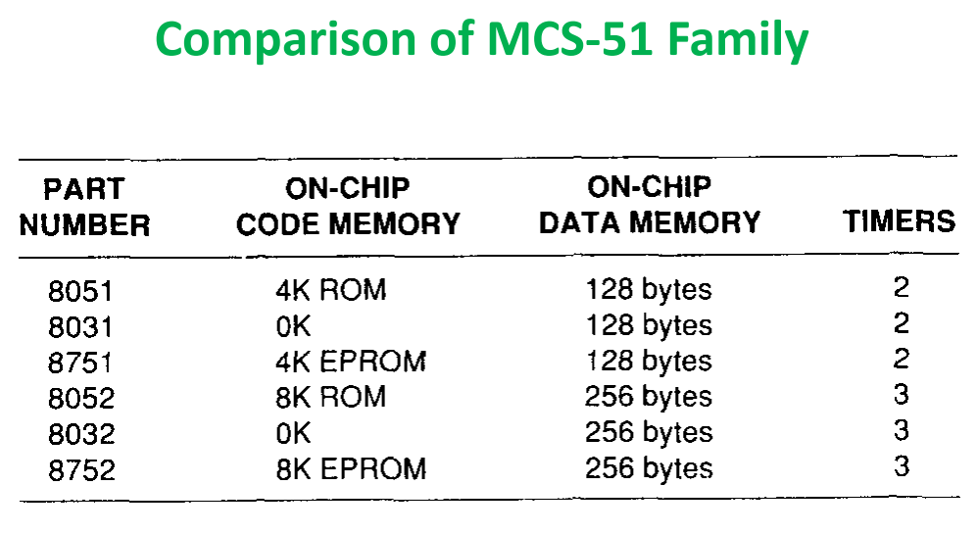
2.1 Introduction to 8051 Microcontroler
1

Slide 6
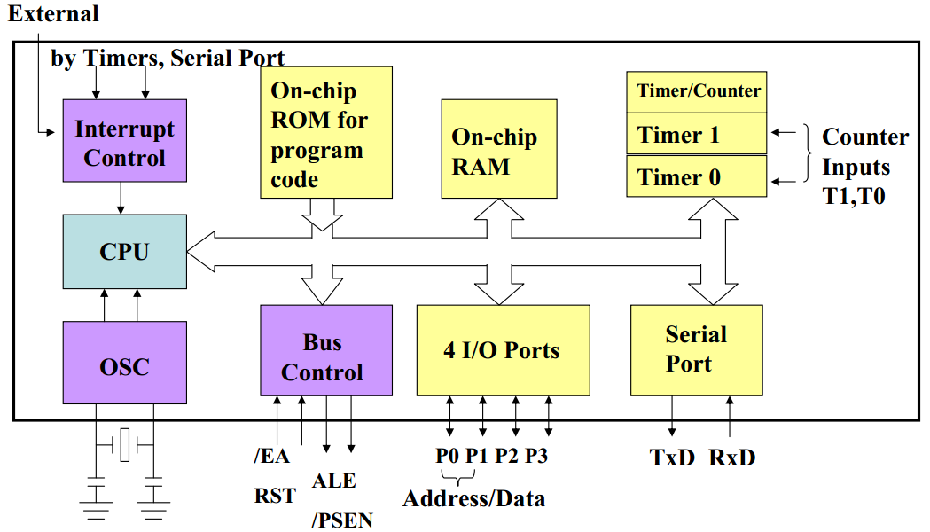
2.2. Block diagram and pins
Block diagram:

Slide 7
Pins
40
30pF
VCC
P0.7
32
AD7
19
XTAL1
33
P0.6
AD6
P0.5
34
AD5
12MHz
P0.4
35
AD4
P0.3
36
AD3
18
XTAL2
P0.2
37
AD2
30pF
P0.1
38
AD1
P0.0
39
AD0
P1.7
8
29
PSEN
P1.6
7
P1.5
6
8051 microcontroller has 40 pins.
30
P1.4
5
ALE
P1.3
4
31
P1.2
3
EA
2
P1.1
1
9
P1.0
RST
P2.7
28
AD15
RD
17
P3.7
P2.6
27
AD14
WR
16
P3.6
P2.5
26
AD13
T0
15
P3.5
P2.4
25
AD12
T1
14
P3.4
P2.3
24
AD11
INT1
13
P3.3
P2.2
23
AD10
INT0
12
P3.2
P2.1
22
AD9
TXD
11
P3.1
P2.0
21
AD8
RXD
10
P3.0
VSS
20

Slide 8
Pins
40
30pF
19
VCC
P0.7
32
AD7
XTAL1
P0.6
33
AD6
P0 (Port 0)
  A dual – purpose port on pins 32 -39.
  a general purpose I/O port.
  A multiplexed address and data bus.
P0.5
34
AD5
12MHz
P0.4
35
AD4
P0.3
36
AD3
18
XTAL2
P0.2
37
AD2
30pF
P0.1
38
AD1
P0.0
39
AD0
P1.7
8
29
PSEN
P1.6
7
P1.5
6
30
P1.4
5
ALE
P1.3
4
31
P1.2
3
EA
2
P1.1
1
9
P1.0
RST
P2.7
28
AD15
RD
17
P3.7
P2.6
27
AD14
WR
16
P3.6
P2.5
26
AD13
T0
15
P3.5
P2.4
25
AD12
T1
14
P3.4
P2.3
24
AD11
INT1
13
P3.3
P2.2
23
AD10
INT0
12
P3.2
P2.1
22
AD9
TXD
11
P3.1
P2.0
21
AD8
RXD
10
P3.0
VSS
20

Slide 9
Pins
40
30pF
19
VCC
P0.7
32
AD7
XTAL1
P0.6
33
AD6
P0.5
34
AD5
12MHz
P0.4
35
AD4
P1 (Port 1)
A I/O port on pins 1-8.
P0.3
36
AD3
18
XTAL2
P0.2
37
AD2
30pF
P0.1
38
AD1
P0.0
39
AD0
P1.7
8
29
PSEN
P1.6
7
P1.5
6
30
P1.4
5
ALE
P1.3
4
31
P1.2
3
EA
2
P1.1
1
9
P1.0
RST
P2.7
28
AD15
RD
17
P3.7
P2.6
27
AD14
WR
16
P3.6
P2.5
26
AD13
T0
15
P3.5
P2.4
25
AD12
T1
14
P3.4
P2.3
24
AD11
INT1
13
P3.3
P2.2
23
AD10
INT0
12
P3.2
P2.1
22
AD9
TXD
11
P3.1
P2.0
21
AD8
RXD
10
P3.0
VSS
20

Slide 10
Pins
40
30pF
19
VCC
P0.7
32
AD7
XTAL1
P0.6
33
AD6
P0.5
34
AD5
12MHz
P0.4
35
AD4
P2 (Port 2)
pins 21 – 28
serving as general purpose I/O or as the high byte of the address bus.
36
P0.3
37
AD3
18
XTAL2
P0.2
AD2
30pF
P0.1
38
AD1
P0.0
39
AD0
P1.7
8
29
PSEN
P1.6
7
P1.5
6
30
P1.4
5
ALE
P1.3
4
31
P1.2
3
EA
2
P1.1
1
9
P1.0
RST
P2.7
28
AD15
RD
17
P3.7
P2.6
27
AD14
WR
16
P3.6
P2.5
26
AD13
T0
15
P3.5
P2.4
25
AD12
T1
14
P3.4
P2.3
24
AD11
INT1
13
P3.3
P2.2
23
AD10
INT0
12
P3.2
P2.1
22
AD9
TXD
11
P3.1
P2.0
21
AD8
RXD
10
P3.0
VSS
20

Slide 11
Pins
40
30pF
19
VCC
P0.7
32
AD7
XTAL1
P0.6
33
AD6
P3 (Port 3)
A general – purpose I/O on pins 21 – 28.
Each pin has a specical feature.
P3.0 – P3.7 hoặc theo byte P3.
P0.5
34
AD5
12MHz
P0.4
35
AD4
P0.3
36
AD3
18
XTAL2
P0.2
37
AD2
30pF
P0.1
38
AD1
P0.0
39
AD0
P1.7
8
29
PSEN
P1.6
7
P1.5
6
30
P1.4
5
Bit | Name | Function
P3.0 | RxD | Receive data for serial port
P3.1 | TxD | Transmit data for serial port
P3.2 | INT0 | External interrupt 0
P3.3 | INT1 | External interrupt 1
P3.4 | T0 | Timer/ Counter 0 external input
P3.5 | T1 | Timer/ Counter 1 external input
P3.6 | WR | External data memory write strobe
P3.7 | RD | External data memory read strobe
ALE
P1.3
4
31
P1.2
3
EA
2
P1.1
1
9
P1.0
RST
P2.7
28
AD15
RD
17
P3.7
P2.6
27
AD14
WR
16
P3.6
P2.5
26
AD13
T0
15
P3.5
P2.4
25
AD12
T1
14
P3.4
P2.3
24
AD11
INT1
13
P3.3
P2.2
23
AD10
INT0
12
P3.2
P2.1
22
AD9
TXD
11
P3.1
P2.0
21
AD8
RXD
10
P3.0
VSS
20

Slide 12
Pins
40
30pF
19
VCC
P0.7
32
AD7
XTAL1
P0.6
33
AD6
P0.5
34
AD5
12MHz
P0.4
35
AD4
XTAL1 and XTAL2
An on – chip oscillator is driven by a crystal connected to pins 18 nad 19.
The nominal crystal frequency is 12MHz.
The on – chip oscillator needn’t be driven by a crystal. A TTL clock source can be connected to XTAL1 and XTAL2.
36
P0.3
37
AD3
18
XTAL2
P0.2
AD2
30pF
P0.1
38
AD1
P0.0
39
AD0
P1.7
8
29
PSEN
P1.6
7
P1.5
6
30
P1.4
5
ALE
P1.3
4
31
P1.2
3
EA
2
P1.1
1
9
P1.0
RST
P2.7
28
AD15
RD
17
P3.7
P2.6
27
AD14
WR
16
P3.6
P2.5
26
AD13
T0
15
P3.5
P2.4
25
AD12
T1
14
P3.4
P2.3
24
AD11
INT1
13
P3.3
P2.2
23
AD10
INT0
12
P3.2
P2.1
22
AD9
TXD
11
P3.1
P2.0
21
AD8
RXD
10
P3.0
VSS
20

Slide 13
Pins
40
30pF
19
VCC
P0.7
32
AD7
XTAL1
P0.6
33
AD6
P0.5
34
AD5
12MHz
P0.4
35
AD4
EA (External Access)
Choose the external memory.
EA=0: Programs execute from external memory.
EA=1: Programs excutes from internal memory
36
P0.3
37
AD3
18
XTAL2
P0.2
AD2
30pF
P0.1
38
AD1
P0.0
39
AD0
P1.7
8
29
PSEN
P1.6
7
P1.5
6
30
P1.4
5
ALE
P1.3
4
31
P1.2
3
EA
2
P1.1
1
9
P1.0
RST
P2.7
28
AD15
RD
17
P3.7
P2.6
27
AD14
WR
16
P3.6
P2.5
26
AD13
T0
15
P3.5
P2.4
25
AD12
T1
14
P3.4
P2.3
24
AD11
INT1
13
P3.3
P2.2
23
AD10
INT0
12
P3.2
P2.1
22
AD9
TXD
11
P3.1
P2.0
21
AD8
RXD
10
P3.0
VSS
20

Slide 14
Pins
40
30pF
19
VCC
P0.7
32
AD7
XTAL1
P0.6
33
AD6
P0.5
34
AD5
12MHz
P0.4
35
AD4
PSEN
(Program Store Enable)
Enable external program memory.
It usuallt connects to Output Enable pin (OE) of EFROM
36
P0.3
37
AD3
18
XTAL2
P0.2
AD2
30pF
P0.1
38
AD1
P0.0
39
AD0
P1.7
8
29
PSEN
P1.6
7
P1.5
6
30
P1.4
5
ALE
P1.3
4
31
P1.2
3
EA
2
P1.1
1
9
P1.0
RST
P2.7
28
AD15
RD
17
P3.7
P2.6
27
AD14
WR
16
P3.6
P2.5
26
AD13
T0
15
P3.5
P2.4
25
AD12
T1
14
P3.4
P2.3
24
AD11
INT1
13
P3.3
P2.2
23
AD10
INT0
12
P3.2
P2.1
22
AD9
TXD
11
P3.1
P2.0
21
AD8
RXD
10
P3.0
VSS
20

Slide 15
Pins
40
30pF
19
VCC
P0.7
32
AD7
XTAL1
P0.6
33
AD6
P0.5
34
AD5
12MHz
P0.4
35
AD4
ALE
(Address Latch Enable)
demultiplexing the address and data bus.
36
P0.3
37
AD3
18
XTAL2
P0.2
AD2
30pF
P0.1
38
AD1
P0.0
39
AD0
P1.7
8
29
PSEN
P1.6
7
P1.5
6
30
P1.4
5
ALE
P1.3
4
31
P1.2
3
EA
2
P1.1
1
D0 – D7
9
P1.0
RST
A0 – A7
P2.7
28
AD15
D
Q
RD
17
P3.7
P2.6
27
AD14
WR
16
P3.6
P2.5
26
AD13
P0 (AD0 – AD7)
T0
15
P3.5
25
14
P3.4
P2.4
AD12
T1
P2.3
24
AD11
G
INT1
13
P3.3
P2.2
23
AD10
ALE
INT0
12
P3.2
P2.1
22
AD9
TXD
11
P3.1
P2.0
21
AD8
RXD
10
P3.0
VSS
20

Slide 16
Pins
ALE
(Address Latch Enable)
When Port 0 is used as the data bus, ALE latches the address into an external register during the first half of a memory cycle. During the second half of the memory cycle Port 0 lines are avaiable for data input and output.
The ALE signal pulse at f=1/6f_{clock}
D0 – D7
A0 – A7
D
Q
P0 (AD0 – AD7)
G
ALE

Slide 17
Pins
40
30pF
19
VCC
P0.7
32
AD7
RST (Reset)
Pin 9 is the master reset for the 8051
When RST =1 ( least two machine cycles), register =00H
P0, P1,P2, P3 = FFH (logic 1)
SP=07H
PC=0000H
XTAL1
P0.6
33
AD6
P0.5
34
AD5
12MHz
P0.4
35
AD4
P0.3
36
AD3
18
XTAL2
P0.2
37
AD2
30pF
P0.1
38
AD1
P0.0
39
AD0
P1.7
8
29
PSEN
P1.6
7
P1.5
6
30
P1.4
5
ALE
P1.3
4
31
P1.2
3
EA
2
P1.1
1
9
P1.0
RST
5V
P2.7
28
AD15
RD
17
P3.7
P2.6
27
AD14
10µF
WR
16
P3.6
P2.5
26
AD13
T0
15
P3.5
P2.4
25
AD12
8051
T1
14
P3.4
24
100Ω
13
P2.3
23
AD11
RST
INT1
12
P3.3
P2.2
AD10
INT0
11
P3.2
P2.1
22
AD9
TXD
P3.1
P2.0
21
AD8
RXD
10
P3.0
VSS
8.2kΩ
20

Slide 18
Pins
40
30pF
19
VCC
P0.7
32
AD7
XTAL1
P0.6
33
AD6
P0.5
34
AD5
12MHz
P0.4
35
AD4
Vcc
  Volt supply for 8051
  +5V
  Pin 40
GND: Ground, pin 20
36
P0.3
37
AD3
18
XTAL2
P0.2
AD2
30pF
P0.1
38
AD1
P0.0
39
AD0
P1.7
8
29
PSEN
P1.6
7
P1.5
6
30
P1.4
5
ALE
P1.3
4
31
P1.2
3
EA
2
P1.1
1
9
P1.0
RST
P2.7
28
AD15
RD
17
P3.7
P2.6
27
AD14
WR
16
P3.6
P2.5
26
AD13
T0
15
P3.5
P2.4
25
AD12
T1
14
P3.4
P2.3
24
AD11
INT1
13
P3.3
P2.2
23
AD10
INT0
12
P3.2
P2.1
22
AD9
TXD
11
P3.1
P2.0
21
AD8
RXD
10
P3.0
VSS
20

Slide 19
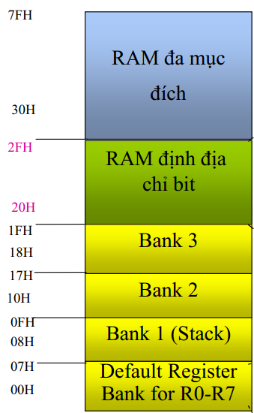
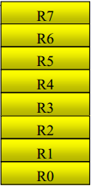
2.3. Memory organization
2.3.1 Internal RAM.
Internal data memory space is divided between internal RAM (00H – 7FH) and specical function registers (80H - FFH).
00H – 1FH: 4 register banks.
  Each banks has 8 register, R0 through R7.
  Default these registers are at addresses 00H – 07H.
General purpose RAM
Bit addressable RAM

Slide 20
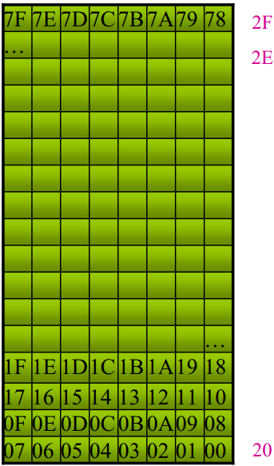
2.3.1. Internal RAM
General purpose RAM
Bit addressable RAM (20H – 2FH).
The 8051 contains 128 bit addressable locations, of which 128 are at byte addresses.
SET 67H; set bit 67H
MOV A, 2DH; read a byte.
Bit addressable RAM

Slide 21
Bit addressable RAM
The idea of individually accessing bits through aoftware is a piwerful feature of microcontrollers. Bits can be set, cleared, ANDed, Ored,… with a single instruction.
The 8051 I/O ports are bit addressable.
Example: to set bit 7FH, the followin instruction:
Microcontrollers::
SETB 7FH
Microprocessors: (bit address 67H is bit at “byte address 2CH”)
MOV A,2FH ; read entire byte
ORL A,#10000000B; set bit
MOV 2FH, A; write back entire byte

Slide 22
General purpose RAM
7F
General purpose RAM
30H – 7FH
RAM can be accessed freely using the direct or indirect addressing modes.
Example:
  MOV A, 30H ; move a byte of data (address 5FH) to A accumulator.
  MOV R1, #30H; move 30H into register R1
  MOV A, @R1 ;move the data “pointed at by R1” into the accumulator.
80 byte
30
2F
7F
7E
7D
7C
7B
7A
79
78
2E
77
76
75
74
73
72
71
70
2D
6F
6E
6D
6C
6B
6A
69
68
Bit addressable .
22
17
16
15
14
13
12
11
10
21
0F
0E
0D
0C
0B
0A
09
08
20
07
06
05
04
03
02
01
00
1F
Bank 3
32 byte
Bank 2
Bank 1
00
Bank 0

Slide 23
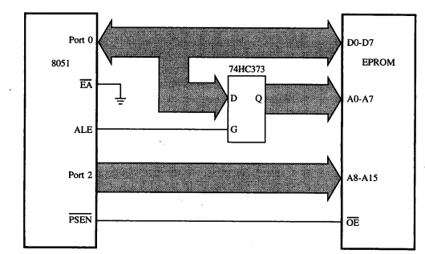
2.3.2 Extenal memory
8051 architecture provides external:
+ 64K Code memory space (ROM)
+ 64K data memory space (RAM)
Accessing external code memory

Slide 24
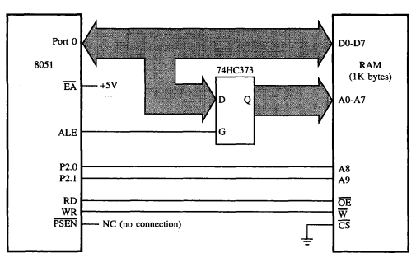
2.3.2. External memory

Slide 25
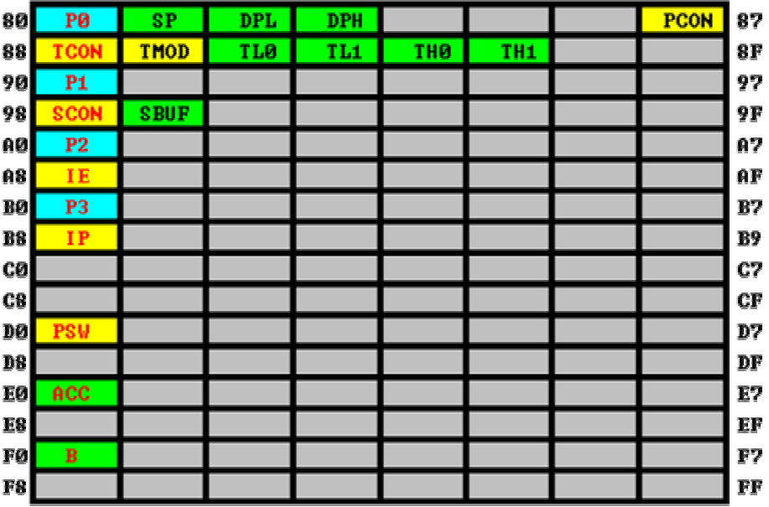
2.4. Special function registers (SFR)
I/O port SFRs
Control SFRs
Other SFRs

Slide 26
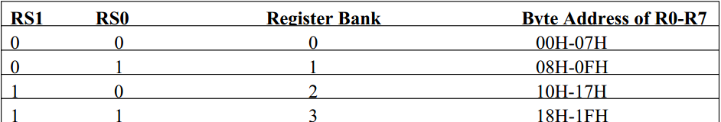
Program status word (PSW)
Thanh ghi PSW
C (CY)
PSW.7
Carry flag
AC
PSW.6
Auxillary carry flag
F0
PSW.5
Flag 0
RS1
PSW.4
Register bank select 1
RS0
PSW.3
Register bank select 0
OV
PSW.2
Overflow flag
--
PSW.1
Reserved
P
PSW.0
Even parity flag

Slide 27
Program status word (PSW)
C (Carry flag)
set if there is a carry out of bit 7 during an add or ser if there is a borrow into bit 7 during a subtract.
MOV A,#FFH
ADD A,#1 : A=100H
Carry flag is serving as a 1-bit register for Boolean instructions operating on bits.
ANL C,25H

Slide 28
Program status word (PSW)
AC (Auxiliary carry)
AC is set if a carry wa genereated out of bit 3 into bit 4
RS1, RS0 – Register bank select bits
Determine the active register bank.
They are cleared after a system reset.

Slide 29




Program status word (PSW)
OV (over flag)
OV is set after an addition or subtraction operation if there was arithmetic overflow. When a signed numbers are added or subtracted, software can examine this bit to determine if the result is in the proper range.
When unsigned numbers are added, the OV bit can be ignored.
Resutt greater than + 127 or less than – 128 will set the OV bit.
8EH represents -116, which is clearly not the correct result of 142, OV bit is set.

Slide 30
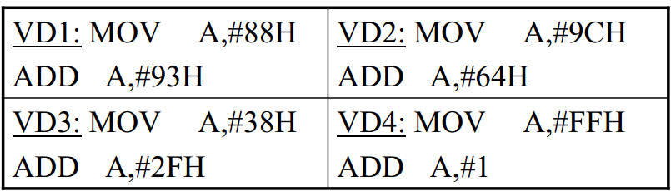
Program status word (PSW)
P (Parity bit)
Establish even parity with the accumulator.
The number of 1-bits in the accumulator plus the P bit is always even.
P bit is used in conjunction with serial port routines to include a parity bit before transmission or to check for parity after reception.
Example:
MOV A,#10101101B
→P=1

Slide 31


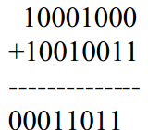

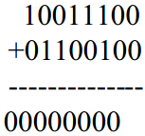






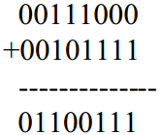


Program status word (PSW)

Slide 32

B register
B register is used with the accumulator for multiply and divide operations.
MUL A,B ; multiplies the 8 –bit unsigned values in A and B and leaves 16-bit result in A (low-byte) and B (high byte).
DIV AB ; divided A by B, leaving the integer result in A and the remainder in B.
B register is bit – addressable (0F0H to 0F7H)

Slide 33
Stack pointer (SP)
SP contains the address of the data item currently on the top of the stack.
“pushing” data on the stack ( increments the SP) and “poping” data off the stack (decrements the SP)
The stack beginning at 60H:
MOV SP,#5FH
  Limit the stack to 32 bytes, since the uppermost address of on –chip RAM is 7FH.
  5FH is used, since the SP increments to 60H before the first push operation.

Slide 34
Stack pointer (SP)
PUSH & POP instructions to temporarily store and retrieve data
ACALL , LCALL, RET, RETI instructions to save and restore the program counter.

Slide 35
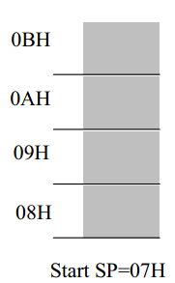
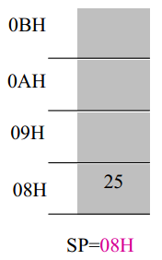
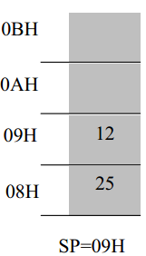
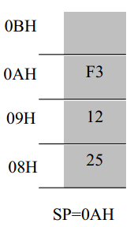
Stack pointer (SP)
Example::
MOV R6,#25H
MOV R1,#12H
MOV R4,#0F3H
PUSH 6
PUSH 1
PUSH 4

Slide 36


Data pointer (DPTR)
DPTR used to access external code or data memory.
A 16 – bit register at addresses 82H and 83H
Example:

Slide 37
Port registers
All ports are bit – addressable
Example: (A motor is connected to Port 1 bit 7)
SETB P1.0
CLR P1.0
Check a device is busy and ready
WAIT: JB P1.5, WAIT

Slide 38
Timer registers
8051 contains 2 16-bits timer/counters
Timer operation is set by the timer mode register (TMOD) and the timer counter register (TCON)

Slide 39
Serial Port registers
8051 contains an on-chip serial port for communicating with serial devices.
SBUF (Serial Data Buffer): Transmit data and receive data
SCON (Serial Port Control Register):choose the modes of operation

Slide 40
Interrupt registers
IE : Interrup enable register at address 0A8H
IP : Interrupt Priority register at address 0B8H

Slide 41
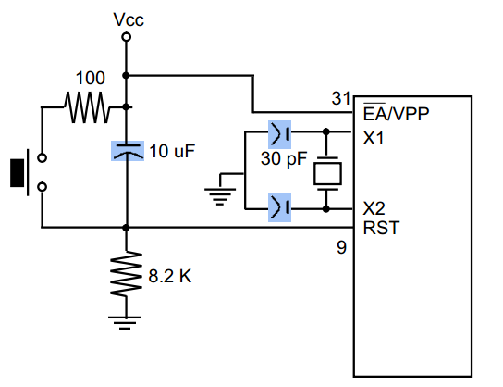
2.5 Reset operation
Manual reset circuit.

Slide 42
Register values after system reset
Registers Contents
PC 0000H
A 00H
B 00H
PSW 00H
SP 07H
DPTR 0000H
P0, P1, P2, P3 FFH
RAM is not affected by a reset operation.

